Slide 1
Class & Object Diagram

Slide 2
Classes
Captures static structure of a system.
Describes a group of objects with the same properties (attributes), behavior (operations), kinds of relationships and semantics.
Often appear as common nouns and noun phrases in problem description.
Objects in a class have the same attributes and forms of behavior.
    Difference in attribute values and specific relationship to other objects.
The choice of classes depends on the nature and scope of an application and is matter of judgment.
For example: Person, Company, process.
If objects are the focus of modeling, why bother with classes?

Slide 3
Objects
A concept, abstraction, or thing with identity that has meaning for an application.
Often appear as proper nouns or specific references in problem descriptions.
All objects have identity and are distinguishable.
The choice of objects depends on judgment and the nature of problem.
Object diagram shows individual objects and their relationship.

Slide 4
Class Diagram
Used for
  General conceptual modeling of the systematics of the application.
  Detailed modeling translating the models into programming code.
Describes the attributes and operations of a class and also the constraints imposed on the system.
widely used in the modeling of object oriented systems.

Slide 5
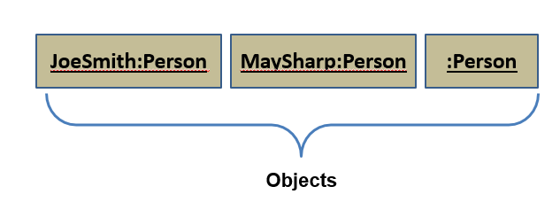
Object Diagram
An object diagram shows individual objects and their relationships.
  Helpful for documenting test cases.
A class diagram corresponds to an infinite set of object diagrams.

Slide 6
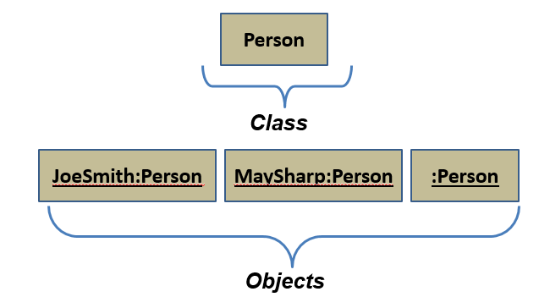
Class and Objects

Slide 7
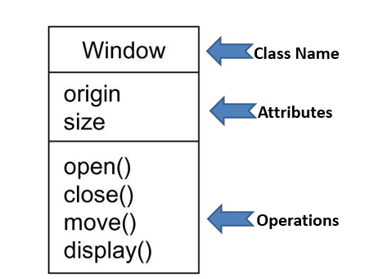
Class Diagram

Slide 8
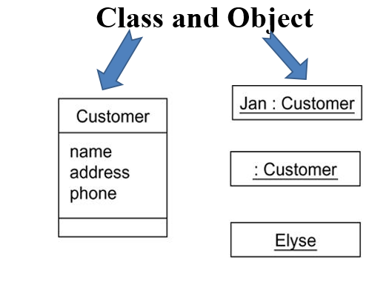
Class and Object
There is the division of class and object.
  A class is an abstraction;
  An object is one concrete appearance of that abstraction.
In the UML, you can model classes as well as objects, as shown in following Figures

Slide 9
Values and Attributes
Attribute is named property of a class that describe a value.
  Name, birthdate, and weight are attributes of Person class.
Value is a piece of data.
  Attribute birthdate has value “21 April 1999”.
Different object may have same or different values for a given attribute.

Slide 10
Operations and Methods
Operation is a function which is applied to or by objects in a class.
  Hire, payincrement are operations of a class Company.
  All objects in a class share same operations.
  Operations may be polymorphic.
Method is the implementation of an operation.
  Print is an operation, while print ASCII file, binary file, and print picture are different methods.

Slide 11
“Order System”
Order and Customer are identified as the two elements of the system and they have a one to many relationship because a customer can have multiple orders.
We would keep Order class is an abstract class and it has two concrete classes (inheritance relationship) SpecialOrder and NormalOrder.
The two inherited classes have all the properties as the Order class. In addition they have additional functions like dispatch() and receive().

Slide 12
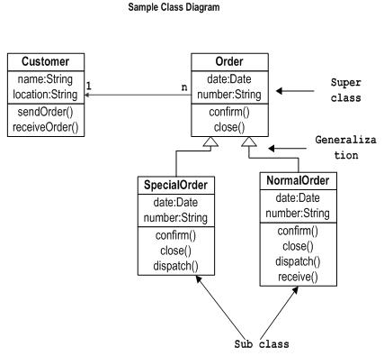

Slide 13
Relationships among Classes
Links
  The basic relationship among objects.
  For example, Amit works for UPES.
  An instance of an association.
Association
  Represents a family of links with common structure and semantics.
  A person works for a company.
  Links of an association connect objects from same classes.
  Binary associations (with two ends) are normally represented as a line.

Slide 14
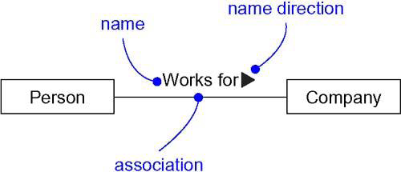

Relationships among Classes
Association name is optional, if unambiguous
  Ambiguity arise when a model has multiple associations among the same classes.
  A person Works for a company and own stock in a company.

Slide 15
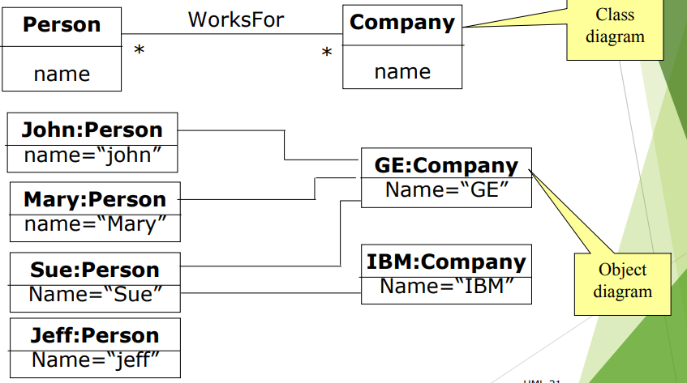
Link and Association

Slide 16
Multiplicity
Multiplicity specifies the number of instances of one class that may relate to a single instance of an associated class.
Multiplicity constrains the number of related objects.
A subset of nonnegative integers.
UML specifies multiplicity with an interval, such as..
0..1 → No instances, or one instance (optional, may).
1 → Exactly one instance.
0..* or * → Zero or more instances.
1..* → One or more instances (at least one).
3..5 → three to five inclusive.

Slide 17
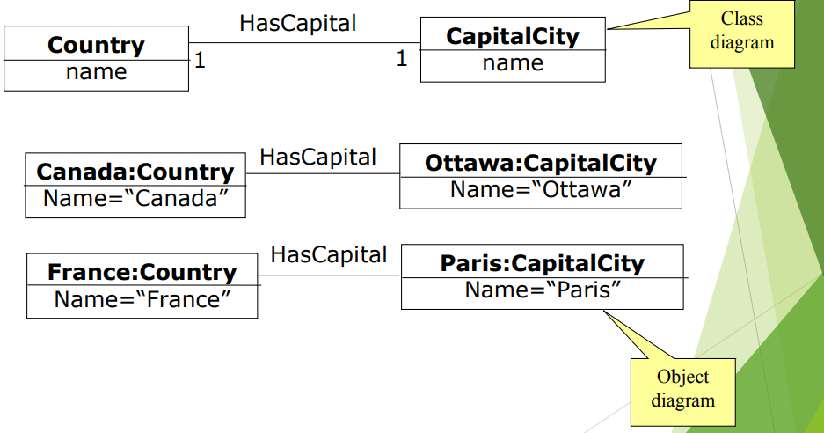
Multiplicity

Slide 18

Association End Names
If we consider one to many association then it has two ends-an end with a multiplicity of “one” and an end with a multiplicity of “many”.
We can also give the name to both the ends.
Association end names often appear as nouns in problem descriptions.

Slide 19
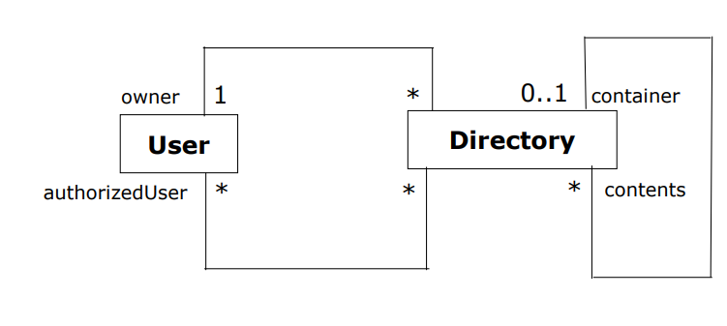
Association End Names
Association end names are necessary for associations between two objects of the same class and for multiple association.
For example container and contents distinguish the two usage of Directory class.

Slide 20
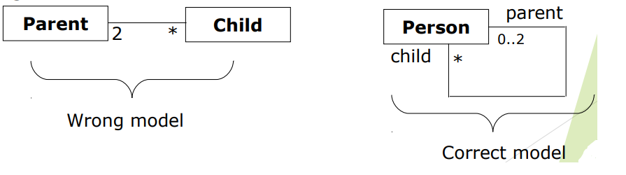
Association End Names
Association end names unify multiple references to the same class.
When constructing class diagram, we have to use proper association end names and not introduce separate class for each reference as shown in below fig.

Slide 21
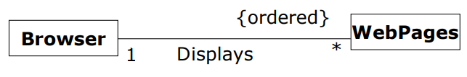
Ordering
Often the objects on a “many” association end have no explicit order and we regard them as a set.
Sometimes the objects have an explicit order.
The Web Browser displays the web pages in some specific order (FCFS). Hence {ordered} keyword is used at the association end.

Slide 22

Bags and Sequence
Ordinarily, a binary association has at most one link for a pair of objects.
Multiple links between a pair of objects denoted by bag or sequence.
A bag is a collection of elements with duplicates allowed.
A sequence is an ordered collection of elements with duplicates allowed.

Slide 23
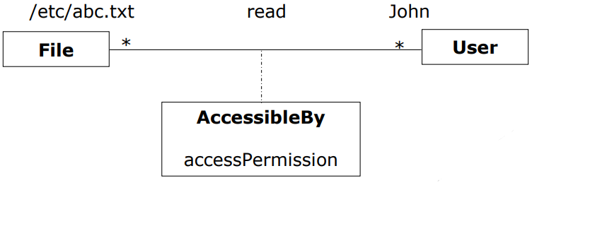
Association Classes
When two classes are related with each other by an association link, then the association itself can have attributes and operations.
Hence, association can be represented by a class.
The UML notation for an association class is a box attached to the association by a dashed line.

Slide 24
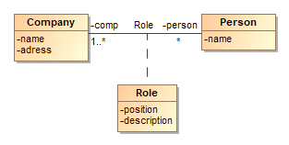
Association Classes

Slide 25
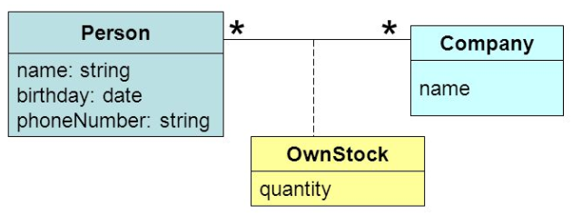
Association Classes

Slide 26
Qualified Associations
A qualified association is an association in which an attribute called the qualifier disambiguates the objects for a “many” association end.
Possible to define for one-to-many and many-to-many association.
A qualifier selects among the target objects, reducing multiplicity from “many” to “one”.
Both models are acceptable, however qualified association adds information.
Example:- A bank services multiple accounts.

Slide 27
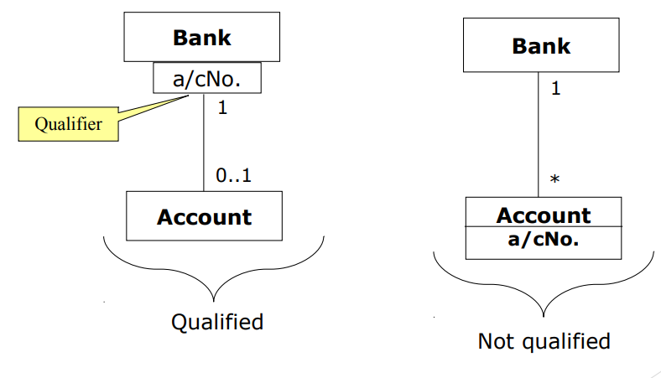
Qualified Associations

Slide 28
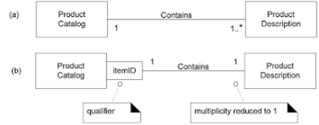
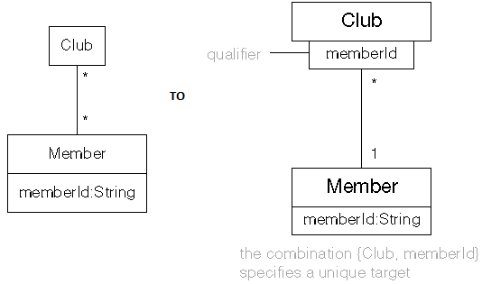

Slide 29
Generalization and Inheritance
Generalization is the relationship between a class (super class) and one or more variations of the class (subclasses).
Super Class (Base class)
  Provides common functionality and data members.
Subclass (Derived class)
  Inherits public and protected members from the super class.
  Can extend or change behavior of super class by overriding methods.
Overriding
  Subclass may override the behavior of its super class.
Relationship represented by hollow arrow.

Slide 30
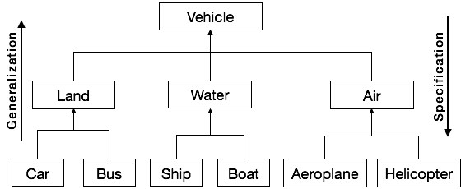
Generalization and Inheritance

Slide 31
Generalization – advantages
Transitive across multiple levels.
Polymorphism
Find common characteristics among classes
Define hierarchies
Reuse of the code
Do not nest the subclasses too deeply.
  Can be difficult to understand.
  Depend upon the judgement.

Slide 32
Accessibility Operators
The class diagram will specify the accessibility for attributes and operations. The most common operators are:
  + public
  # protected
  - private
  ~ package level
Considerations when choosing visibility
  Comprehension
  Extensibility
  Context

Slide 33
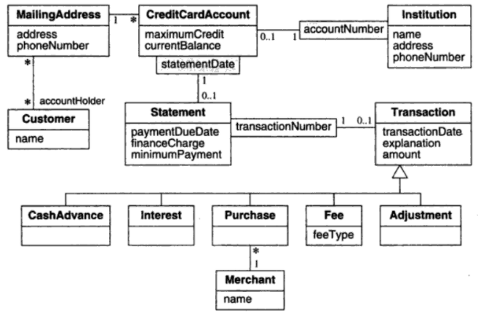
Example

Slide 34
Aggregation
Aggregation is a part of association.
It is used to represent whole-part relationship. It is normally posses has-a relationship.
If two objects are tightly bound by a part-whole relationship, it is an aggregation.
If two objects are usually considered as independent, even though they may often be linked, it is an association.
Aggregation is drawn like association, except a small diamond indicates the assembly end.

Slide 35
Aggregation Questions
Would you use phrase “PART OF”.
Do some operations on the whole automatically applies to its parts?
Do some attribute values propagate from whole to all or some of its parts.
Is one class is subordinate to other?

Slide 36
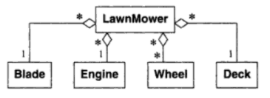
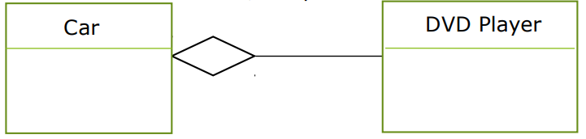
Aggregation
Here, DVD player and car are the two classes that can be associated by aggregate relationship.
Here, Car can exists without DVD player and DVD player can be exists without car.
Similarly, example-2.

Slide 37
Aggregation Vs. Composition
The UML has two forms of part-whole relationships: a general form called aggregation and a more restrictive form called composition.
Composition is a form of aggregation with two additional constraints.
  A part can belong to at most one assembly.
  Once a constituent part has been assigned an assembly, it has a coincident lifetime with the assembly.
Thus composition implies ownership of the parts by the whole.
Deletion of assembly object triggers deletion of its parts.

Slide 38
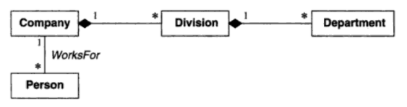

Composition

Slide 39
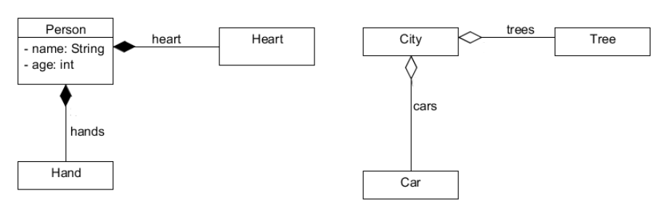
Aggregation Vs. Composition

Slide 40
Multiplicity of Attribute
Specifies number of possible values for each instantiation of an attribute.
The most common values are: [1], [*], [0..1].
Specifies whether an attribute is mandatory or optional.
Indicate whether attribute is single valued or a collection.
Person
Name: string[1] Address: string[1..*] Phone number: string[*] Birthdate:date[1]

Slide 41
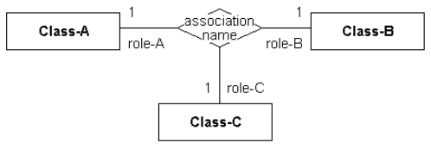
n-Ary Association
An n-Ary Association is used to model complex relationships between three or more classes.
It is not commonly-employed, but can be used to good effect where there is a dependent relationship between several classes.
Any n-Ary association may be drawn as a diamond with a solid line for each association end connecting the diamond to the classifier that is the end’s type.

Slide 42
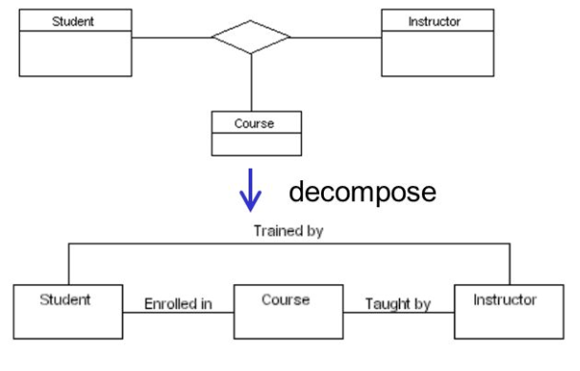
n-Ary Association
Try to avoid n-ary association as programming languages do not support it.
Most of them can be decomposed into binary associations.

Slide 43
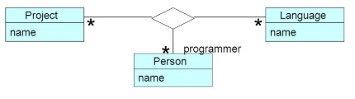
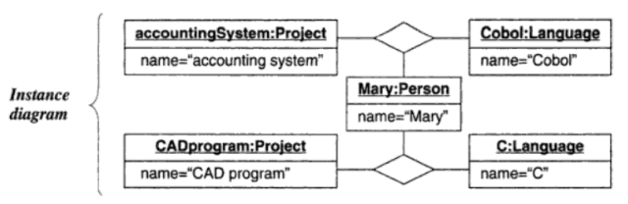
n-Ary Association

Slide 44
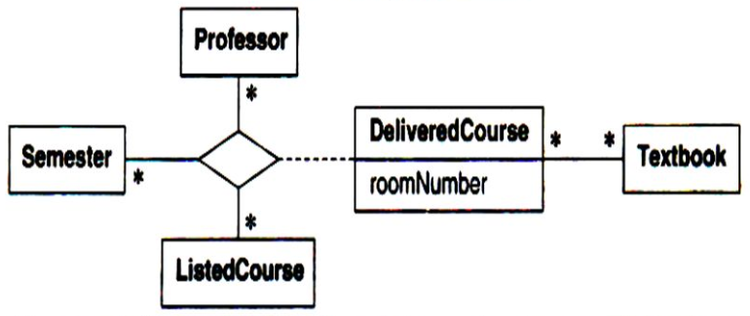
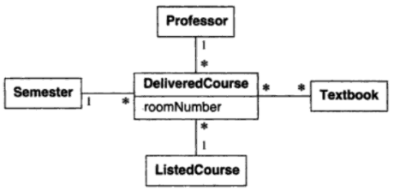
n-Ary Association with Association Class

Slide 45
Abstract Classes
An abstract class is a class that has no direct instances but whose descendant classes have direct instances.
A concrete class is a class that is instantiable that means it can have direct instances.
Only concrete classes may be leaf classes in an inheritance tree.
In UML notation an abstract class name is listed in an italic font or by placing the keyword {abstract} below or after the name.

Slide 46
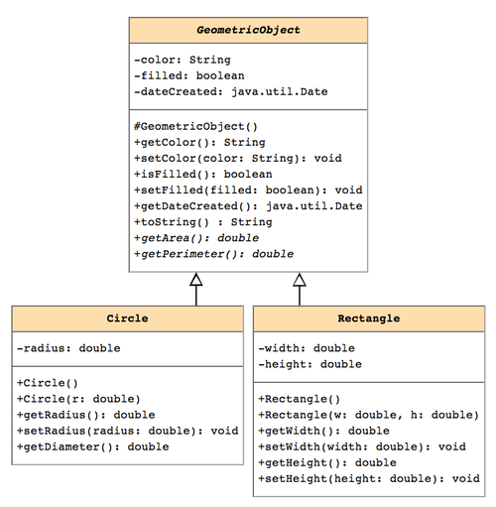

Slide 47
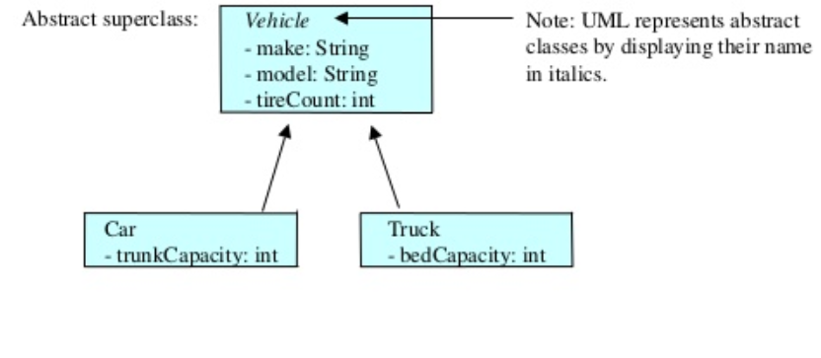
Abstract Classes

Slide 48
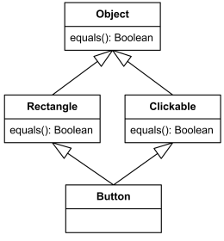
Multiple Inheritance
Permits a class to have more than one superclass and inherit features from all parents.
Increased opportunity of reuse.

Slide 49
Packages
Used to grasp the entirety of a large model.
Package is a group of classes, associations, generalizations and lesser packages with a common theme.
Tips for devising packages:
  Carefully define package scope
  Define each class in single package
  Make packages cohesive
Package name

Slide 50
Case Study: University System
A university has one or more departments and rooms.
Departments have many professors and a professor can enrolled to one department only.
A professor can be full-professor, associate professor or assistant professor.
The rooms of university can be used as office or classrooms.
The professor and other employee are person who are working in the office.

Slide 51
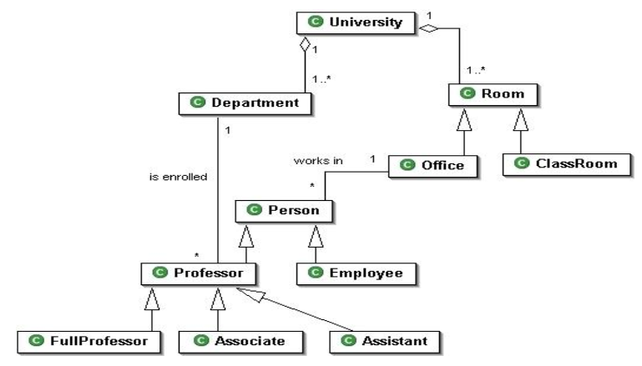
Solution

Slide 52
Class Diagram for a Hockey League
Assumptions: each player only plays on one team, each captain only captains one team, each team only plays in one league.
Draw a UML class diagram representing the following elements from the problem domain for a Hockey League. A Hockey League is made up of at least 4 hockey teams. Each hockey team is composed of 6-12 players and 1 player is the captain of the team. A team has a name and registration number. Player has a name, a number and a position. Hockey teams play games against each other. Each game has a score card and a location. Each team also has a coach. A coach has a number of accreditations levels and experience letter. A coach can provide coaching to multiple teams. Coaches and players are people having name and address. A league also has registration number and teams dynamically participate in the league. Draw a class diagram for this information with appropriate relationships and multiplicities.

Slide 53
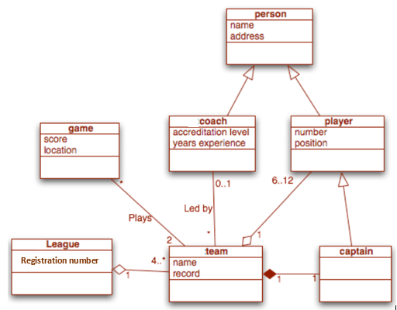

Slide 54
Case Study
Prepare a class model for the hotel management system. The system should supports chain of hotels. A hotel contains two categories of rooms: executive and normal, both AC and non-AC. The customers of executive rooms can avail extra facilities like games, swimming, food service in rooms, etc. The booking is possible by internet or by phone. If the booking is through phone, process is done by receptionist, and if booking is done through internet the process is carried out by customer through hotel website. Depending on the number of days customer stays, appropriate bill is generated. The bill also contains amount for transport, food and other facilities enjoyed by the customer along with necessary taxes. The manager should be able to generate reports like list of customers staying in the hotel, list of rooms empty, monthly/yearly income, etc.

Slide 55
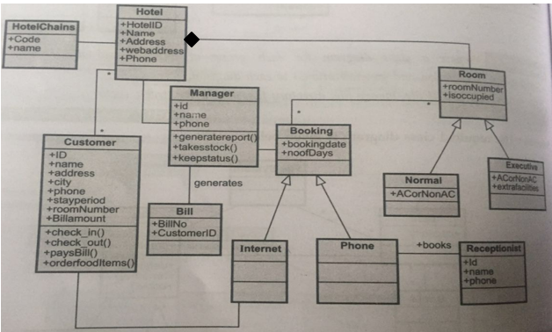
Solution

Slide 56
Draw the class diagram
A school has a principal, many students, and many teachers. Each of these persons has a name, birthdate, and may borrow and return books. The principal evaluates the teachers. A school board supervises multiple schools and can hire and fire the principal/teacher for each school. A school has many playgrounds and rooms. Each room has many chairs and doors. Rooms include restrooms and classrooms. Each classroom has many computers and desks.

Slide 57
